Slide 1
Module 8: Network Layer
Introduction to Networks v7.0 (ITN)
Notes:
Cisco Networking Academy Program
Introduction to Networks v7.0 (ITN)
Module 8: Network Layer

Slide 2
Network Layer Characteristics
Notes:
8 – Network Layer
8.1 – Network Layer Characteristics

Slide 3
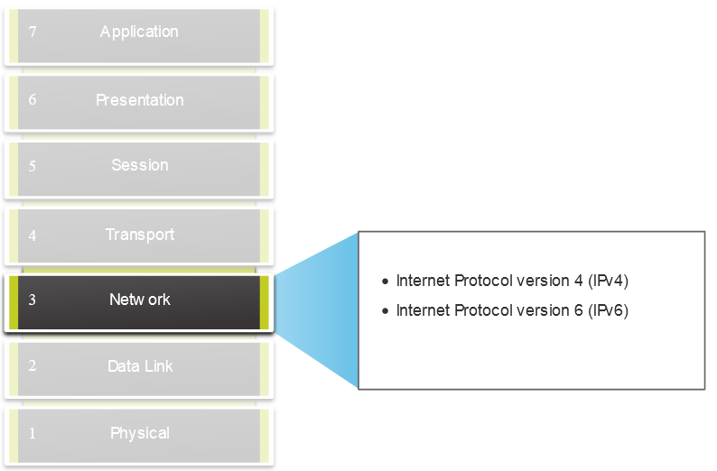
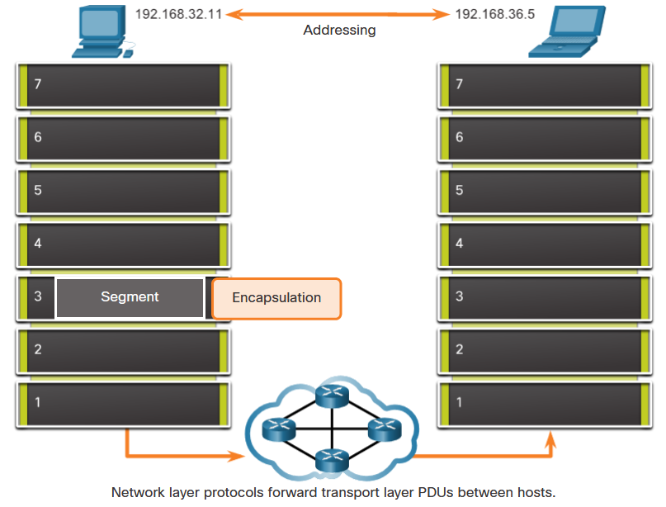
Network Layer Characteristics The Network Layer
Provides services to allow end devices to exchange data
IP version 4 (IPv4) and IP version 6 (IPv6) are the principle network layer communication protocols.
The network layer performs four basic operations:
Addressing end devices
Encapsulation
Routing
De-encapsulation
Notes:
8 – Network Layer
8.1 – Network Layer Characteristics
8.1.1 – The Network Layer

Slide 4
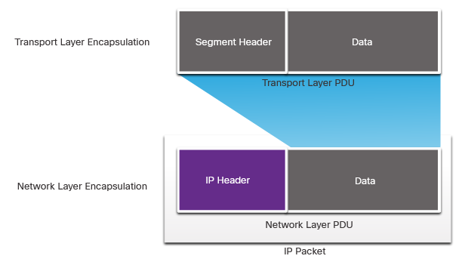
Network Layer Characteristics IP Encapsulation
IP encapsulates the transport layer segment.
IP can use either an IPv4 or IPv6 packet and not impact the layer 4 segment.
IP packet will be examined by all layer 3 devices as it traverses the network.
The IP addressing does not change from source to destination.
Note: NAT will change addressing, but will be discussed in a later module.
Notes:
8 – Network Layer
8.1 – Network Layer Characteristics
8.1.2 – IP Encapsulation

Slide 5
Network Layer Characteristics Characteristics of IP
IP is meant to have low overhead and may be described as:
Connectionless
Best Effort
Media Independent
Notes:
8 – Network Layer
8.1 – Network Layer Characteristics
8.1.3 – Characteristics of IP

Slide 6
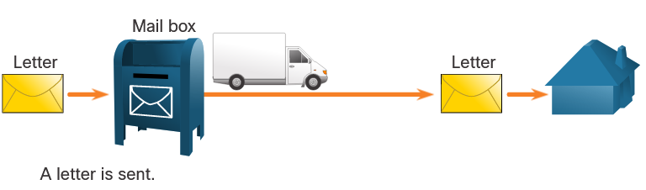
Network Layer Characteristics Connectionless
IP is Connectionless
IP does not establish a connection with the destination before sending the packet.
There is no control information needed (synchronizations, acknowledgments, etc.).
The destination will receive the packet when it arrives, but no pre-notifications are sent by IP.
If there is a need for connection-oriented traffic, then another protocol will handle this (typically TCP at the transport layer).
Notes:
8 – Network Layer
8.1 – Network Layer Characteristics
8.1.4 – Connectionless

Slide 7
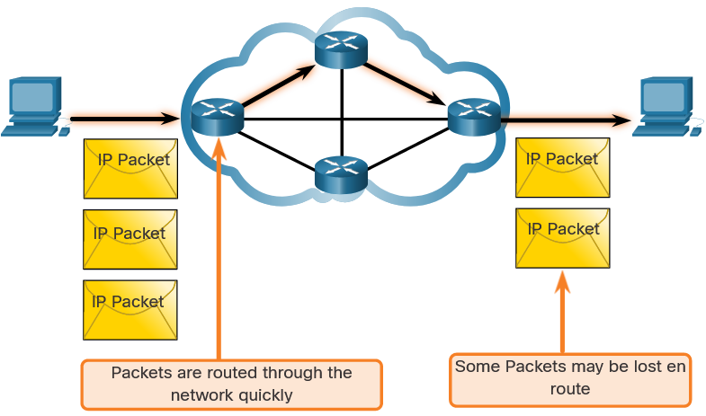
Network Layer Characteristics Best Effort
IP is Best Effort
IP will not guarantee delivery of the packet.
IP has reduced overhead since there is no mechanism to resend data that is not received.
IP does not expect acknowledgments.
IP does not know if the other device is operational or if it received the packet.
Notes:
8 – Network Layer
8.1 – Network Layer Characteristics
8.1.5 – Best Effort

Slide 8
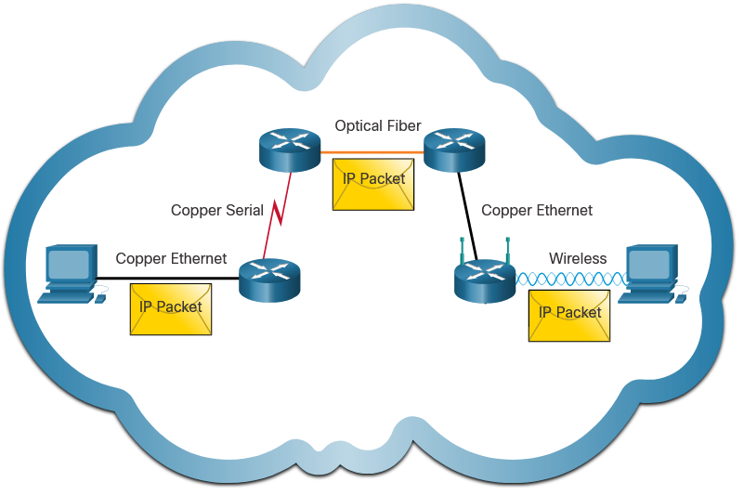
Network Layer Characteristics Media Independent
IP is unreliable:
It cannot manage or fix undelivered or corrupt packets.
IP cannot retransmit after an error.
IP cannot realign out of sequence packets.
IP must rely on other protocols for these functions.
IP is media Independent:
IP does not concern itself with the type of frame required at the data link layer or the media type at the physical layer.
IP can be sent over any media type: copper, fiber, or wireless.
Notes:
8 – Network Layer
8.1 – Network Layer Characteristics
8.1.6 – Media Independent
8.1.7 Check Your Understanding – IP Characteristics

Slide 9
Network Layer Characteristics Media Independent (Contd.)
The network layer will establish the Maximum Transmission Unit (MTU).
Network layer receives this from control information sent by the data link layer.
The network then establishes the MTU size.
Fragmentation is when Layer 3 splits the IPv4 packet into smaller units.
Fragmenting causes latency.
IPv6 does not fragment packets.
Example: Router goes from Ethernet to a slow WAN with a smaller MTU
Notes:
8 – Network Layer
8.1 – Network Layer Characteristics
8.1.6 – Media Independent
8.1.7 Check Your Understanding – IP Characteristics

Slide 10
IPv4 Packet
Notes:
8 – Network Layer
8.2 – IPv4 Packet

Slide 11
IPv4 Packet IPv4 Packet Header
IPv4 is the primary communication protocol for the network layer.
The network header has many purposes:
It ensures the packet is sent in the correct direction (to the destination).
It contains information for network layer processing in various fields.
The information in the header is used by all layer 3 devices that handle the packet
Notes:
8 – Network Layer
8.2 – IPv4 Packet
8.2.1 – IPv4 Packet Header

Slide 12
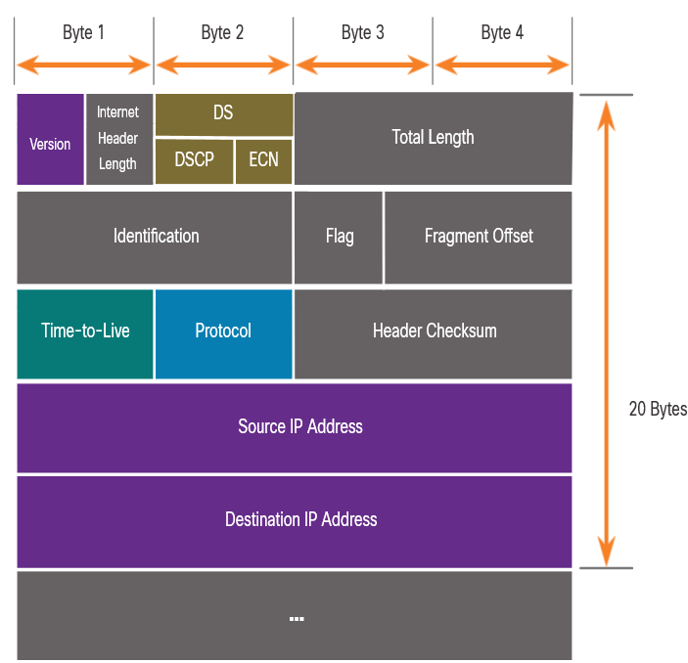
IPv4 Packet IPv4 Packet Header Fields
The IPv4 network header characteristics:
It is in binary.
Contains several fields of information
Diagram is read from left to right, 4 bytes per line
The two most important fields are the source and destination.
Protocols may have one or more functions.
Notes:
8 – Network Layer
8.2 – IPv4 Packet
8.2.2 – IPv4 Packet Header Fields

Slide 13
IPv4 Packet IPv4 Packet Header Fields
Significant fields in the IPv4 header:
Function | Description
Version | This will be for v4, as opposed to v6, a 4 bit field= 0100
Differentiated Services | Used for QoS: DiffServ – DS field or the older IntServ – ToS or Type of Service
Header Checksum | Detect corruption in the IPv4 header
Time to Live (TTL) | Layer 3 hop count. When it becomes zero the router will discard the packet.
Protocol | I.D.s next level protocol: ICMP, TCP, UDP, etc.
Source IPv4 Address | 32 bit source address
Destination IPV4 Address | 32 bit destination address
Notes:
8 – Network Layer
8.2 – IPv4 Packet
8.2.2 – IPv4 Packet Header Fields

Slide 14
IPv6 Packets
Notes:
8 – Network Layer
8.3 – IPv6 Packets

Slide 15
IPv6 Packets Limitations of IPv4
IPv4 has three major limitations:
IPv4 address depletion – We have basically run out of IPv4 addressing.
Lack of end-to-end connectivity – To make IPv4 survive this long, private addressing and NAT were created. This ended direct communications with public addressing.
Increased network complexity – NAT was meant as temporary solution and creates issues on the network as a side effect of manipulating the network headers addressing. NAT causes latency and troubleshooting issues.
Notes:
8 – Network Layer
8.3 – IPv6 Packets
8.3.1 – Limitations of IPv4

Slide 16
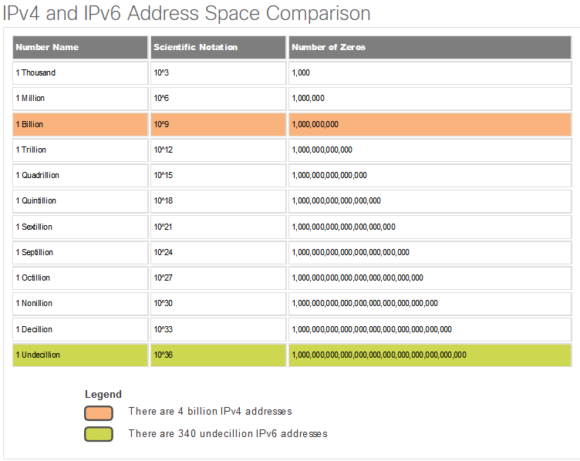
IPv6 Packets IPv6 Overview
IPv6 was developed by Internet Engineering Task Force (IETF).
IPv6 overcomes the limitations of IPv4.
Improvements that IPv6 provides:
Increased address space – based on 128 bit address, not 32 bits
Improved packet handling – simplified header with fewer fields
Eliminates the need for NAT – since there is a huge amount of addressing, there is no need to use private addressing internally and be mapped to a shared public address
Notes:
8 – Network Layer
8.3 – IPv6 Packets
8.3.2 – IPv6 Overview

Slide 17
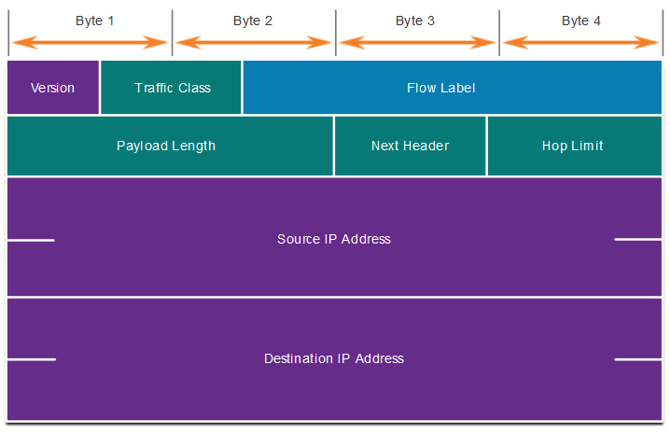
IPv6 Packets IPv4 Packet Header Fields in the IPv6 Packet Header
The IPv6 header is simplified, but not smaller.
The header is fixed at 40 Bytes or octets long.
Several IPv4 fields were removed to improve performance.
Some IPv4 fields were removed to improve performance:
Flag
Fragment Offset
Header Checksum
Notes:
8 – Network Layer
8.3 – IPv6 Packets
8.3.3 – IPv4 Packet Header Fields in the IPv6 Packet Header

Slide 18
IPv6 Packets IPv6 Packet Header
Significant fields in the IPv6 header:
Function | Description
Version | This will be for v6, as opposed to v4, a 4 bit field= 0110
Traffic Class | Used for QoS: Equivalent to DiffServ – DS field
Flow Label | Informs device to handle identical flow labels the same way, 20 bit field
Payload Length | This 16-bit field indicates the length of the data portion or payload of the IPv6 packet
Next Header | I.D.s next level protocol: ICMP, TCP, UDP, etc.
Hop Limit | Replaces TTL field Layer 3 hop count
Source IPv4 Address | 128 bit source address
Destination IPV4 Address | 128 bit destination address
Notes:
8 – Network Layer
8.3 – IPv6 Packets
8.3.4 – IPv6 Packet Header

Slide 19
How a Host Routes
Notes:
8 – Network Layer
8.4 – How a Host Routes

Slide 20
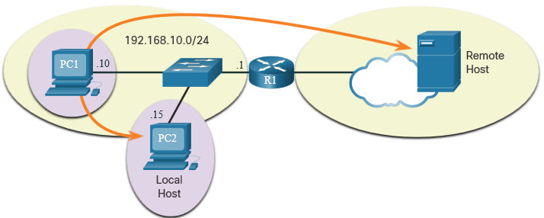
How a Host Routes Host Forwarding Decision
Packets are always created at the source.
Each host devices creates their own routing table.
A host can send packets to the following:
Itself – 127.0.0.1 (IPv4), ::1 (IPv6)
Local Hosts – destination is on the same LAN
Remote Hosts – devices are not on the same LAN
Notes:
8 – Network Layer
8.4 – How a Host Routes
8.4.1 – Host Forwarding Decision

Slide 21
How a Host Routes Host Forwarding Decision (Cont.)
The Source device determines whether the destination is local or remote
Method of determination:
IPv4 – Source uses its own IP address and Subnet mask, along with the destination IP address
IPv6 – Source uses the network address and prefix advertised by the local router
Local traffic is dumped out the host interface to be handled by an intermediary device.
Remote traffic is forwarded directly to the default gateway on the LAN.
Notes:
8 – Network Layer
8.4 – How a Host Routes
8.4.1 – Host Forwarding Decision (Cont.)

Slide 22
How a Host Routes Default Gateway
A router or layer 3 switch can be a default-gateway.
Features of a default gateway (DGW):
It must have an IP address in the same range as the rest of the LAN.
It can accept data from the LAN and is capable of forwarding traffic off of the LAN.
It can route to other networks.
If a device has no default gateway or a bad default gateway, its traffic will not be able to leave the LAN.
Notes:
8 – Network Layer
8.4 – How a Host Routes
8.4.2 – Default Gateway

Slide 23
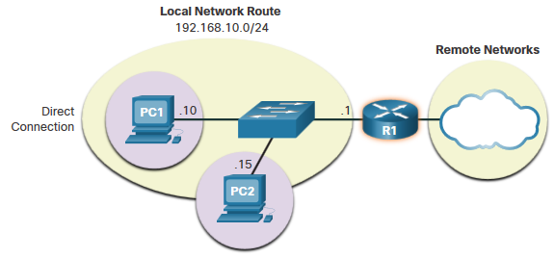
How a Host Routes A Host Routes to the Default Gateway
The host will know the default gateway (DGW) either statically or through DHCP in IPv4.
IPv6 sends the DGW through a router solicitation (RS) or can be configured manually.
A DGW is static route which will be a last resort route in the routing table.
All device on the LAN will need the DGW of the router if they intend to send traffic remotely.
Notes:
8 – Network Layer
8.4 – How a Host Routes
8.4.3 – A Host Routes to the Default Gateway

Slide 24
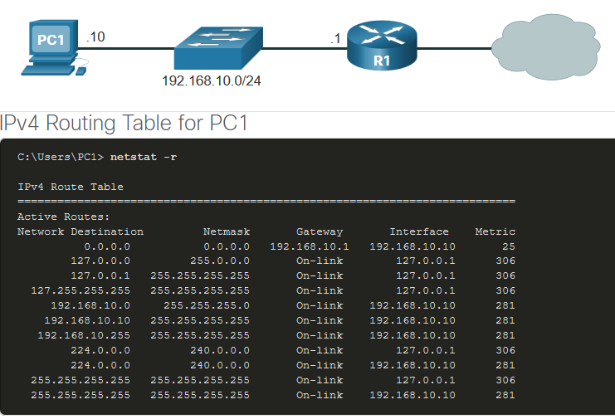
How a Host Routes Host Routing Tables
On Windows, route print or netstat -r to display the PC routing table
Three sections displayed by these two commands:
Interface List – all potential interfaces and MAC addressing
IPv4 Routing Table
IPv6 Routing Table
Notes:
8 – Network Layer
8.4 – How a Host Routes
8.4.4 – Host Routing Tables
8.4.5 – Check Your Understanding – How a Host Routes

Slide 25
Introduction to Routing
Notes:
8 – Network Layer
8.5 – Introduction to Routing

Slide 26
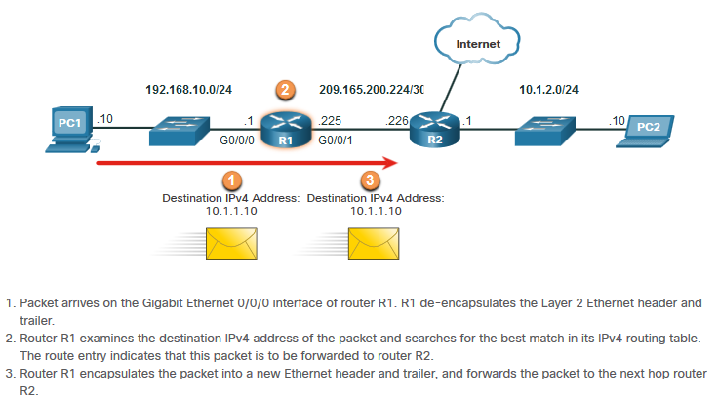
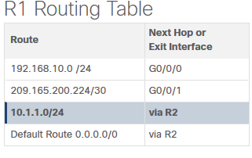
Introduction to Routing Router Packet Forwarding Decision
What happens when the router receives the frame from the host device?
Notes:
8 – Network Layer
8.5 – Introduction to Routing
8.5.1 – Router Packet Forwarding Decision

Slide 27
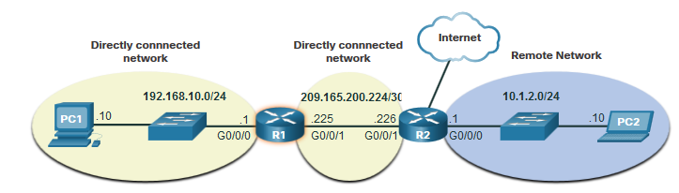
Introduction to Routing IP Router Routing Table
There three types of routes in a router’s routing table:
Directly Connected – These routes are automatically added by the router, provided the interface is active and has addressing.
Remote – These are the routes the router does not have a direct connection and may be learned:
Manually – with a static route
Dynamically – by using a routing protocol to have the routers share their information with each other
Default Route – this forwards all traffic to a specific direction when there is not a match in the routing table
Notes:
8 – Network Layer
8.5 – Introduction to Routing
8.5.2 – IP Router Routing Table

Slide 28
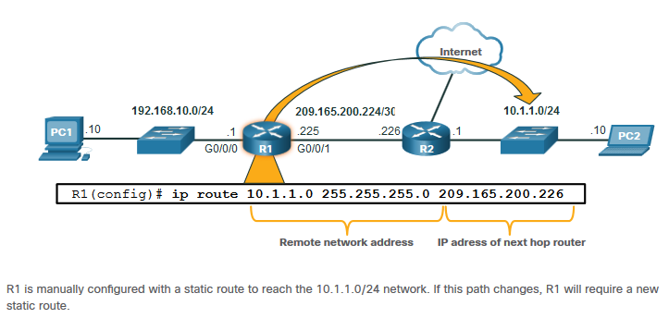
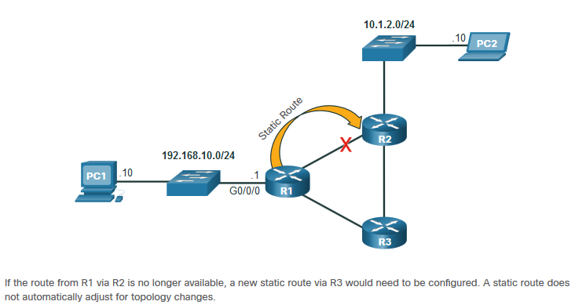
Introduction to Routing Static Routing
Static Route Characteristics:
Must be configured manually
Must be adjusted manually by the administrator when there is a change in the topology
Good for small non-redundant networks
Often used in conjunction with a dynamic routing protocol for configuring a default route
Notes:
8 – Network Layer
8.5 – Introduction to Routing
8.5.3 – Static Routing

Slide 29
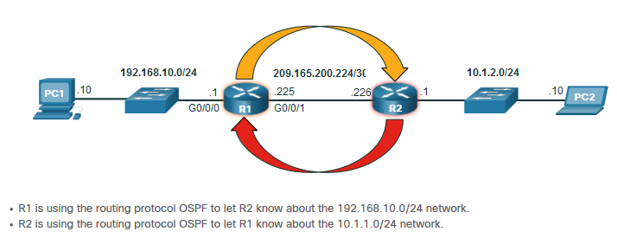
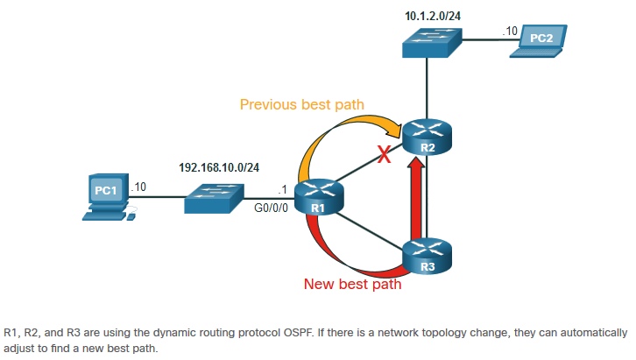
Introduction to Routing Dynamic Routing
Dynamic Routes Automatically:
Discover remote networks
Maintain up-to-date information
Choose the best path to the destination
Find new best paths when there is a topology change
Dynamic routing can also share static default routes with the other routers.
Notes:
8 – Network Layer
8.5 – Introduction to Routing
8.5.4 – Dynamic Routing

Slide 30
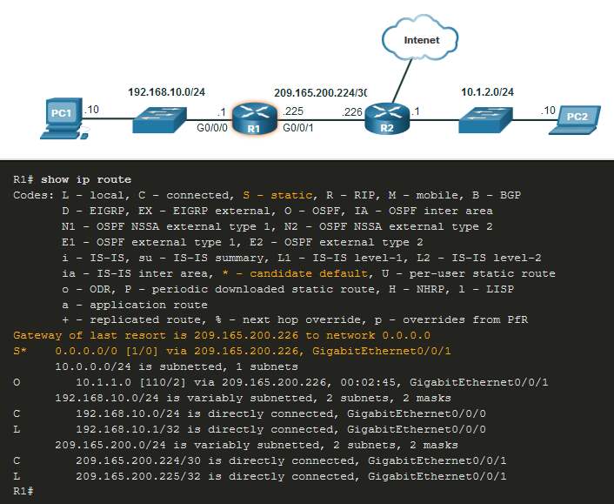
Introduction to Routing Introduction to an IPv4 Routing Table
The show ip route command shows the following route sources:
L - Directly connected local interface IP address
C – Directly connected network
S – Static route was manually configured by an administrator
O – OSPF
D – EIGRP
This command shows types of routes:
Directly Connected – C and L
Remote Routes – O, D, etc.
Default Routes – S*
Notes:
8 – Network Layer
8.5 – Introduction to Routing
8.5.6 – Introduction to an IPv4 Routing Table
8.5.7 – Check Your Understanding – Introduction to Routing

Slide 31
MAC and IP
Notes:
9 - Address Resolution
9.1 MAC and IP

Slide 32
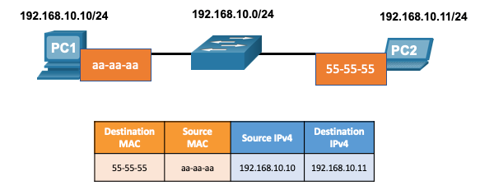
MAC and IP Destination on Same Network
There are two primary addresses assigned to a device on an Ethernet LAN:
Layer 2 physical address (the MAC address) – Used for NIC to NIC communications on the same Ethernet network.
Layer 3 logical address (the IP address) – Used to send the packet from the source device to the destination device.
Layer 2 addresses are used to deliver frames from one NIC to another NIC on the same network. If a destination IP address is on the same network, the destination MAC address will be that of the destination device.
Notes:
9 – Address Resolution
9.1 – MAC and IP
9.1.1 – Destination on Same Network

Slide 33
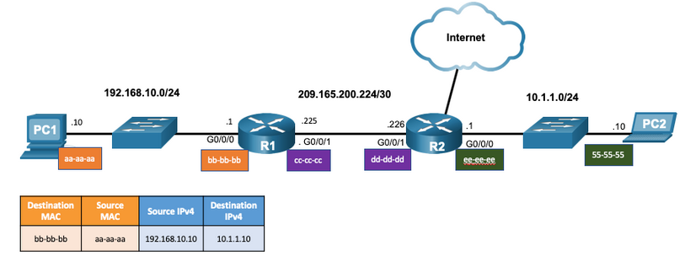
MAC and IP Destination on Remote Network
When the destination IP address is on a remote network, the destination MAC address is that of the default gateway.
ARP is used by IPv4 to associate the IPv4 address of a device with the MAC address of the device NIC.
ICMPv6 is used by IPv6 to associate the IPv6 address of a device with the MAC address of the device NIC.
Notes:
9 – Address Resolution
9.1 – MAC and IP
9.1.2 – Destination on Remote Network

Slide 34
ARP
Notes:
9 - Address Resolution
9.2 ARP

Slide 35
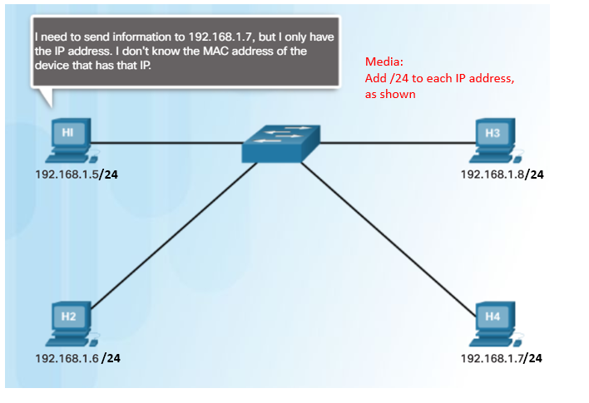
ARP ARP Overview
A device uses ARP to determine the destination MAC address of a local device when it knows its IPv4 address.
ARP provides two basic functions:
Resolving IPv4 addresses to MAC addresses
Maintaining an ARP table of IPv4 to MAC address mappings
Notes:
9 – Address Resolution
9.2 – ARP
9.2.1 – ARP Overview

Slide 36
ARP ARP Functions
To send a frame, a device will search its ARP table for a destination IPv4 address and a corresponding MAC address.
If the packet’s destination IPv4 address is on the same network, the device will search the ARP table for the destination IPv4 address.
If the destination IPv4 address is on a different network, the device will search the ARP table for the IPv4 address of the default gateway.
If the device locates the IPv4 address, its corresponding MAC address is used as the destination MAC address in the frame.
If there is no ARP table entry is found, then the device sends an ARP request.
Notes:
9 – Address Resolution
9.2 – ARP
9.2.2 – ARP Functions

Slide 37
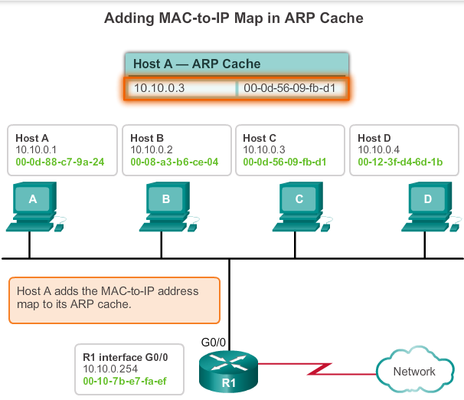
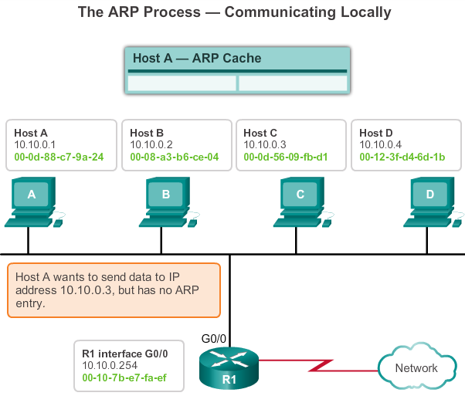
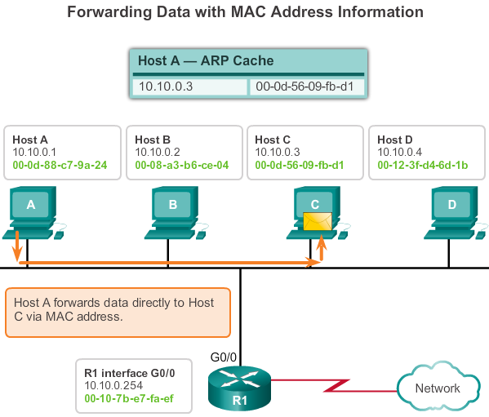
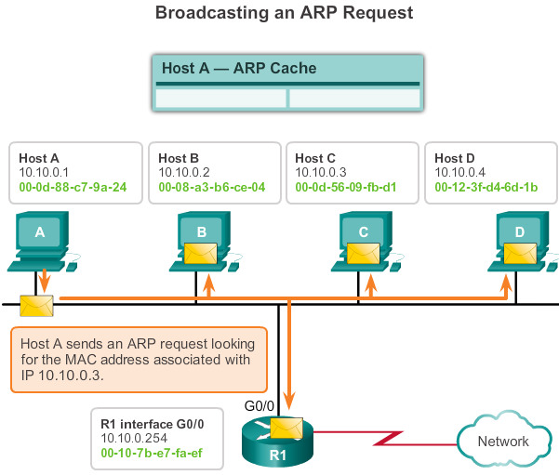
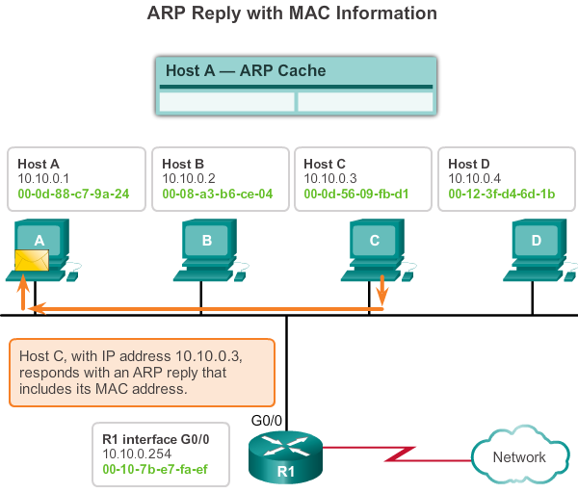
ARP ARP Operation
Step 1
Step 3
Step 2
Step 5
Step 4
Notes:
5.2.1.3 ARP Operation

Slide 38
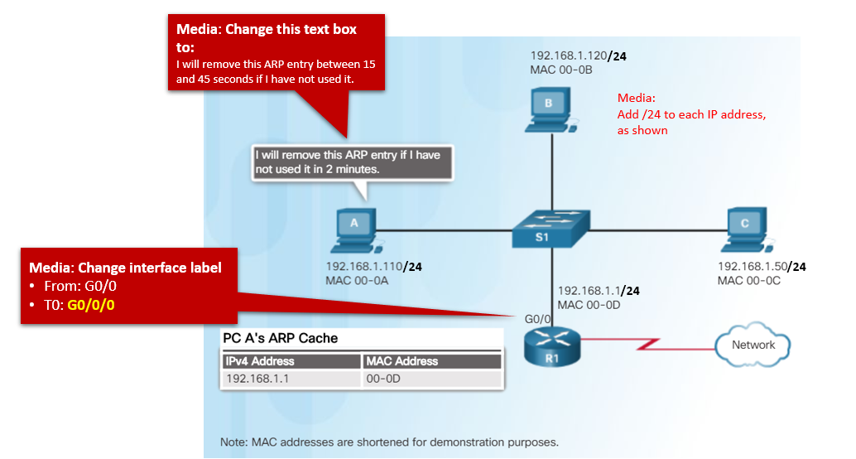
ARP Removing Entries from an ARP Table
Entries in the ARP table are not permanent and are removed when an ARP cache timer expires after a specified period of time.
The duration of the ARP cache timer differs depending on the operating system.
ARP table entries can also be removed manually by the administrator.
Notes:
9 – Address Resolution
9.2 – ARP
9.2.6– Removing Entries from an ARP Table

Slide 39
ARP ARP Tables on Networking Devices
The show ip arp command displays the ARP table on a Cisco router.
The arp –a command displays the ARP table on a Windows 10 PC.
R1# show ip arp
Protocol Address Age (min) Hardware Addr Type Interface
Internet 192.168.10.1 - a0e0.af0d.e140 ARPA GigabitEthernet0/0/0
C:\Users\PC> arp -a
Interface: 192.168.1.124 --- 0x10
Internet Address Physical Address Type
192.168.1.1 c8-d7-19-cc-a0-86 dynamic
192.168.1.101 08-3e-0c-f5-f7-77 dynamic
Notes:
9 – Address Resolution
9.2 – ARP
9.2.7 – ARP Tables on Networking Devices

Slide 40
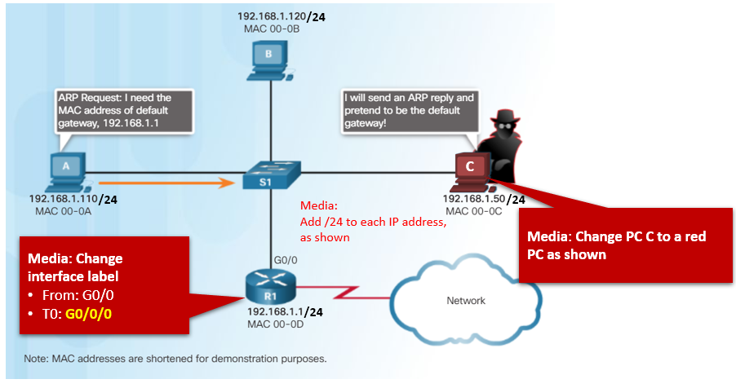
ARP ARP Issues – ARP Broadcasting and ARP Spoofing
ARP requests are received and processed by every device on the local network.
Excessive ARP broadcasts can cause some reduction in performance.
ARP replies can be spoofed by a threat actor to perform an ARP poisoning attack.
Enterprise level switches include mitigation techniques to protect against ARP attacks.
Notes:
9 – Address Resolution
9.2 – ARP
9.2.8 – ARP Issues – ARP Broadcast and ARP Spoofing

